Slide 1

Audible Data Cleaning Project Using power Query Editor.
Presented by : Shubhangi Chetan Sapkale.

Slide 2


Slide 3
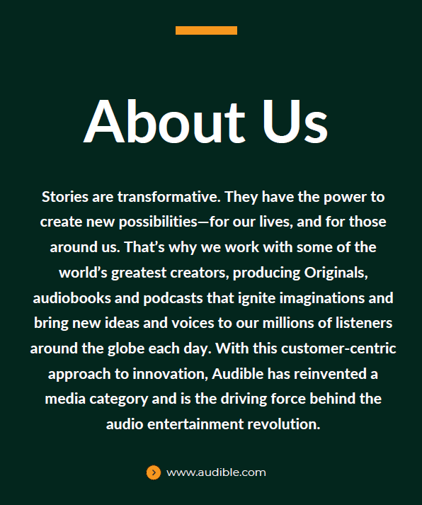

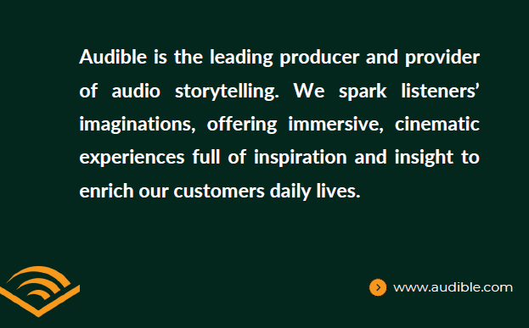
ABOUT US

Slide 4
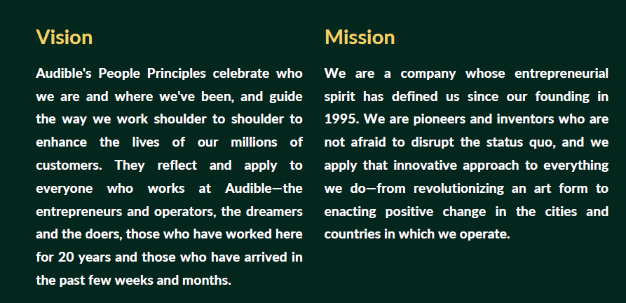

Slide 5




Slide 6
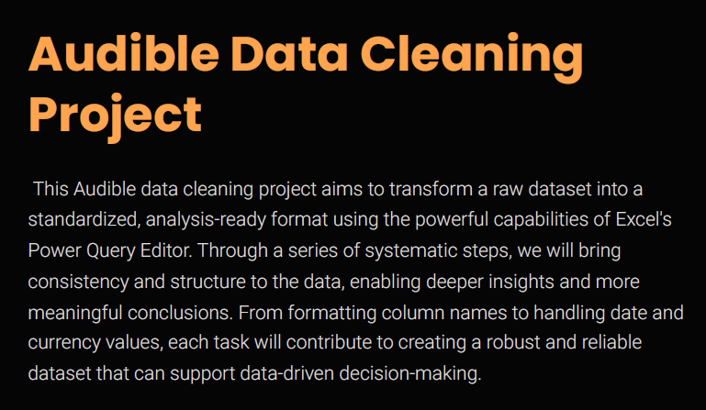

Slide 7
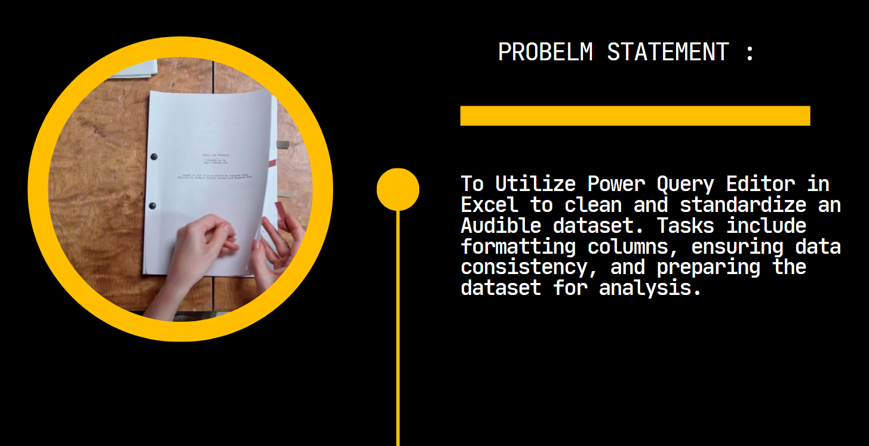

Slide 8
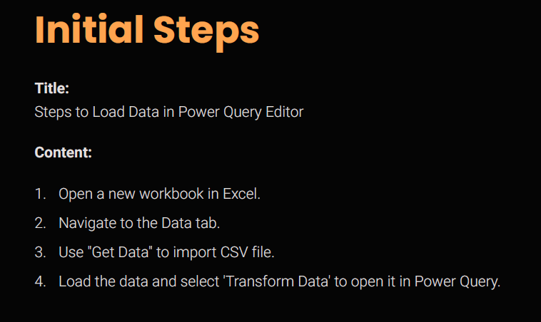


Slide 9
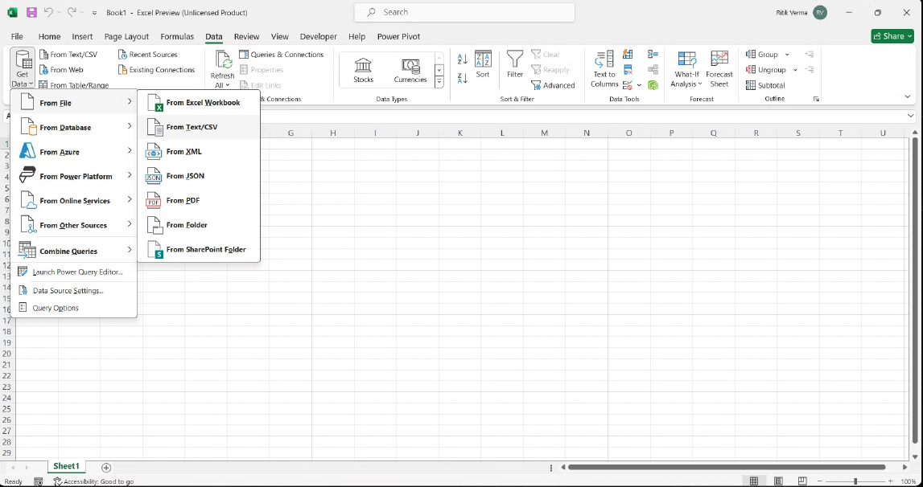

Slide 10
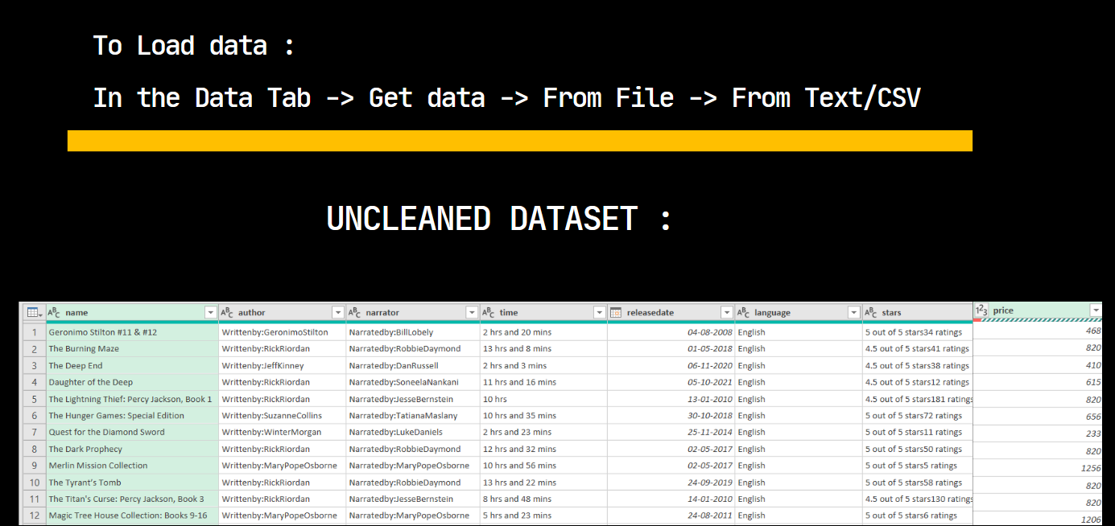

Slide 11
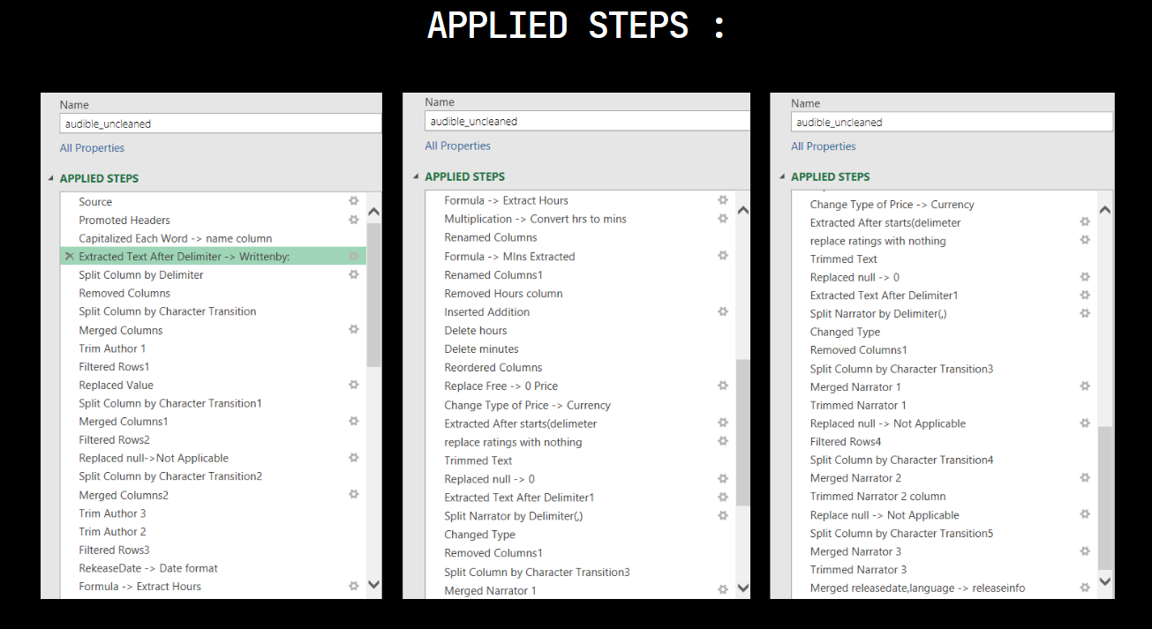

Slide 12
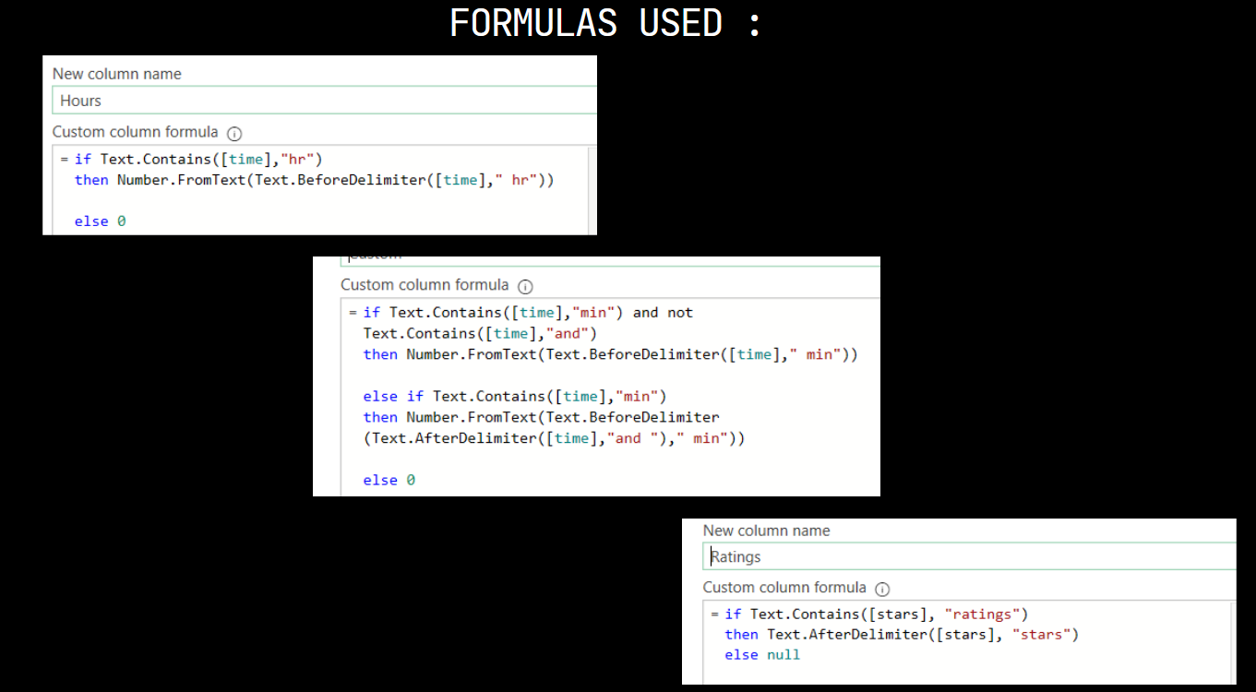

Slide 13
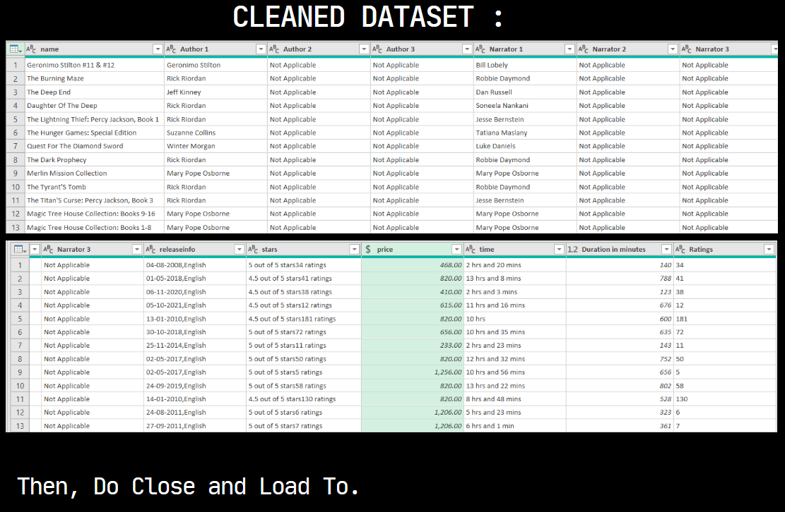

Slide 14


Slide 15



www.linkedin.com/in/shubhangi-sapkale-63795717a

